Slide 1
Facility Location MIP Optimization
Ahad Mohamed

Slide 2
Client Scenario
A retailer wants to choose which facilities to open to serve customer demand
Goal
Minimize:
Facility opening (fixed) costs
Customer-to-facility shipping distances
Proposed Business Value
Reduces expansion cost of facility openings
Ensures full customer coverage by facilities
Provides a transparent, data-driven site selection strategy

Slide 3
MIP Model Overview
Decision Variables
y_f ∈ {0,1} – open facility f
x_{c,f} ∈ {0,1} – assign customer c to facility f
All decision variables are yes/no binary
Key Constraints
Each customer is assigned to exactly one facility
Customers can only be assigned to open facilities
Minimize the number of facilities to have no overlap
Facility opening budget of $235 thousand
Notes:
Facility Location Problem

Slide 4
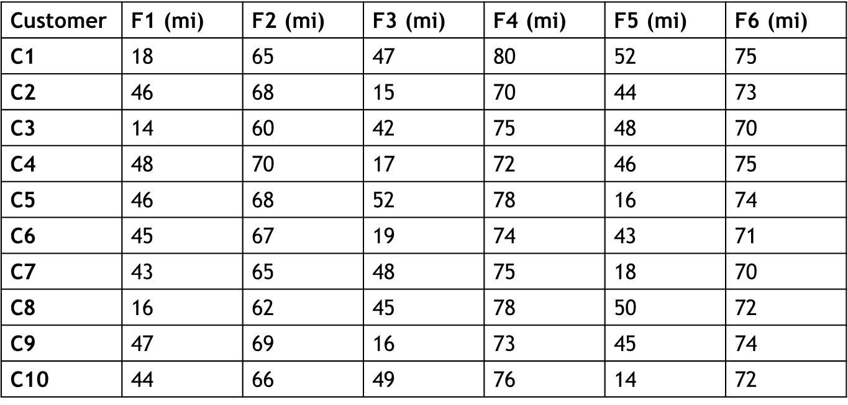
Facility & Customer Data
Facility | Opening Cost
F1 | 70
F2 | 75
F3 | 80
F4 | 90
F5 | 72
F6 | 88

Slide 5
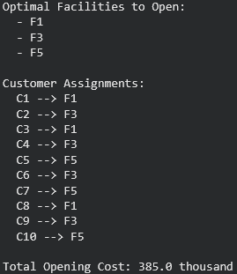
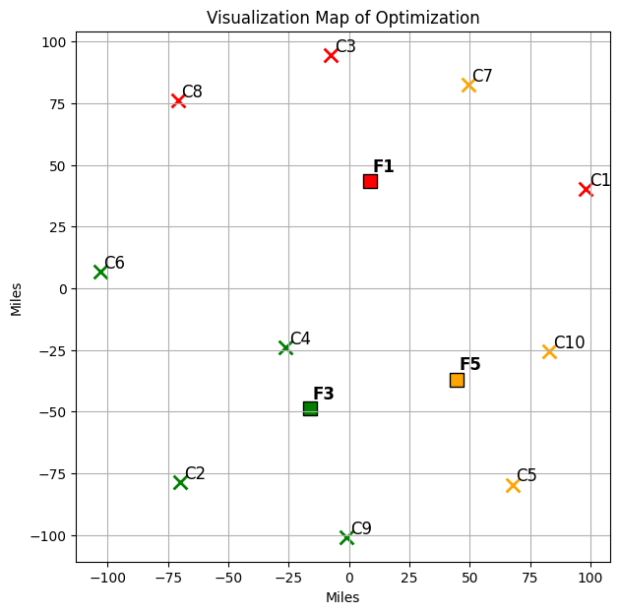
MIP Optimization Results

Slide 6
Insights and Next Steps
Limitations
No capacity limits
No shipping/delivery budget restrictions
Deterministic distances
Small illustrative data set
Future Explorations
Add facility capacity limits
Add maximum or minimum number of facilities
Add service-time constraints

